Slide 1
Stigler Diet Project
Project Presentation
Aurora Travers, Alex Prado, Ivan Louize Winoto, Lilly Patty, Young Ha
Notes:
We are group 6, and our project is about Stigler Diet project. I am Aurora, …

Slide 2
01
About the project
Background Information

Slide 3
Could we apply a methodology between the interactions of food, prices, and nutrition, to find an optimal minimal cost while maintaining nutritional requirements?
Notes:
We wanted to answer the question: Could we apply a methodology between the interactions of food, prices, and nutrition, to find an optimal minimal cost while maintaining nutritional requirements? Which means we want to find the food that has the lowest price with the highest nutritional values.

Slide 4

Stigler Diet Project
Developed by George Stigler, a Nobel Prize winner
George Dantzig developed the simplex algorithm
There are libraries in Python such as OR-Tools, Pulp, or SciPy for solving the problem
DISCLAIMER: Stigler diet is only a guideline
Notes:
The Stigler diet project was developed by george stigler, and he received the nobel prize for solving this problem. There are several methods to solve this problem. You could use the simplex algorithm, or built in libraries in Python such as OR-tools, pulp, or scipy. In this project we used or-tools. Disclaimer: while the Stigler diet is not recommended for its lack of food diversification, it could potentially be used to reduce food cost in specific cases.

Slide 5
02
Tasks Completed

Slide 6
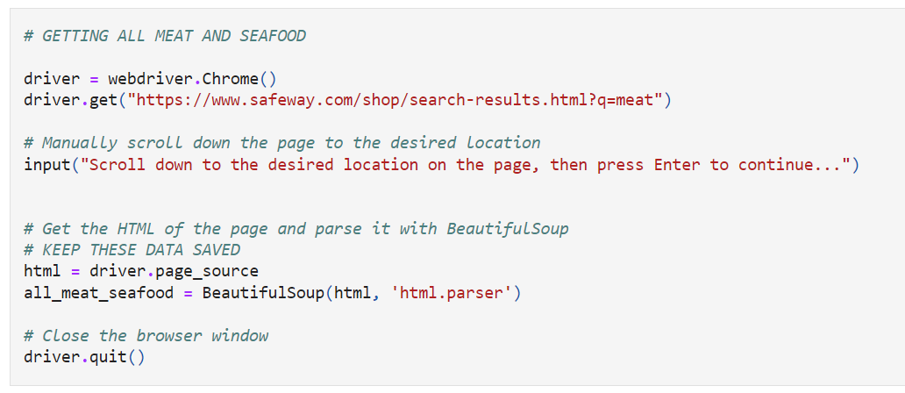
Web Scraping
Notes:
We web scrapped three websites: safeway, trader joes, and costco. I will show how we web scrapped safeway, and present costco’s results.
This is how we web scrapped safeway.
webdriver.chrome is a module in the Python library selenium, which is used for automating web browsers. Specifically, webdriver.chrome is a class that allows you to control the Chrome web browser using Python code.
driver.page_source is a method that retrieves the HTML source code of the webpage currently displayed in the driver browser window. This HTML source code is assigned to the variable html.
We then used beautifulsoup to get the desired html.

Slide 7
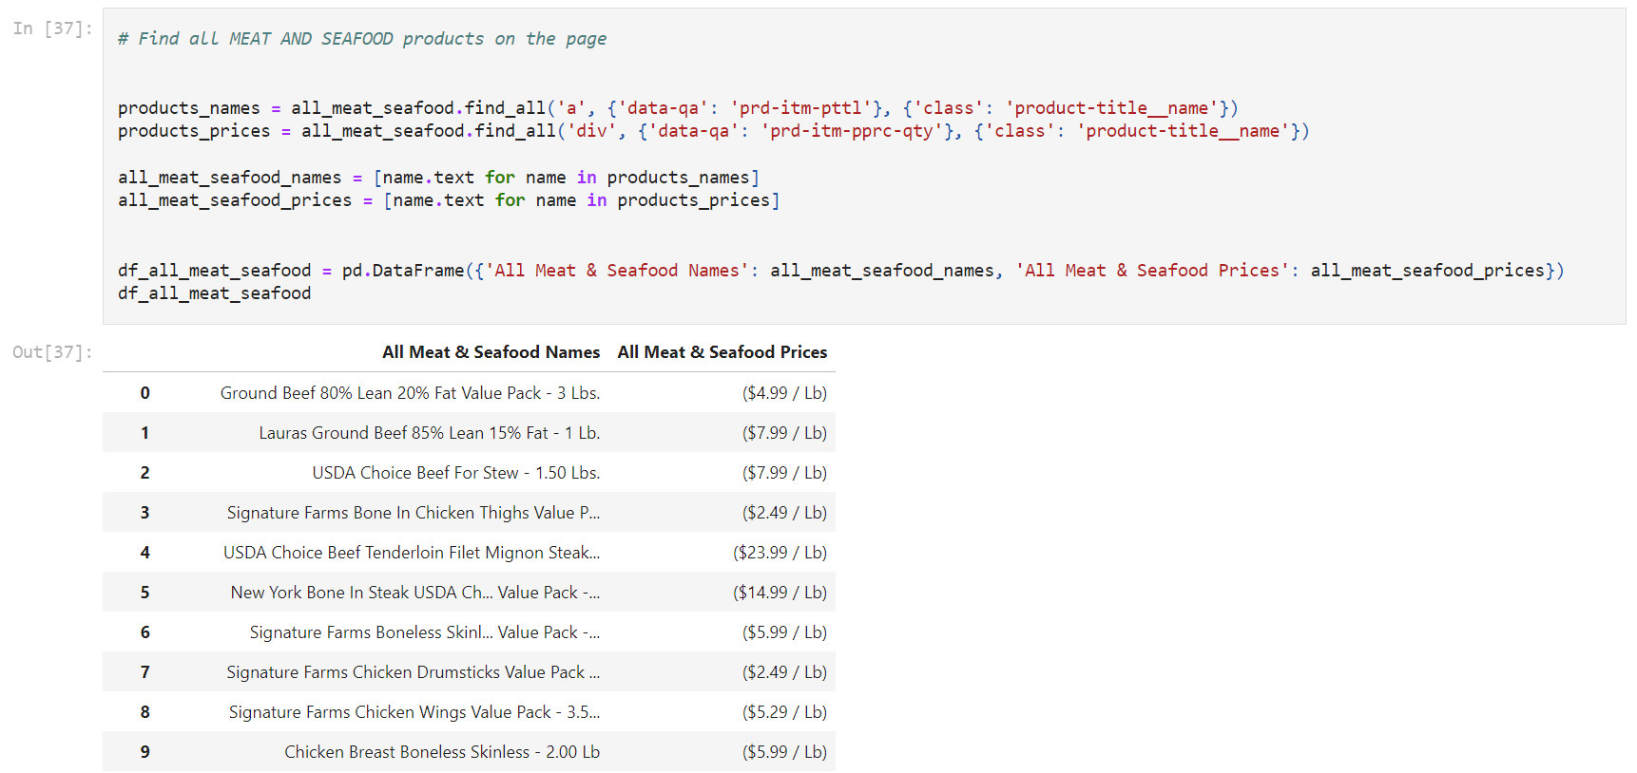
Web Scraping
Notes:
We then use find all to extract all ‘a’ and ‘div’ tags. Then, we extract the text of those tags. With the text we extracted, we made a pandas dataframe.
Data inconsistencies, such as missing prices, were addressed, and the information was compiled into a CSV file. Due to the difficulty in obtaining nutritional values, we sourced this data from the USDA's FNDDS Nutrient Values dataset. We implemented the Levenshtein Distance to match food names and nutritional values, eliminating empty rows and converting units for linear optimization.

Slide 8
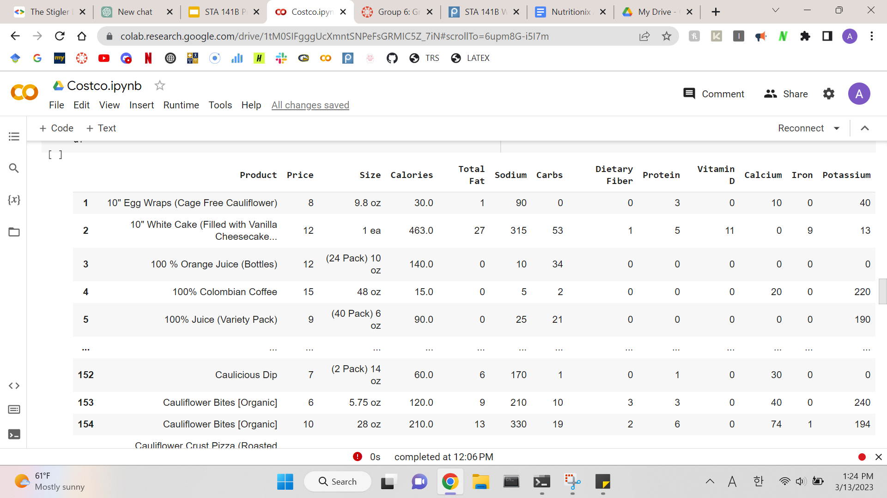
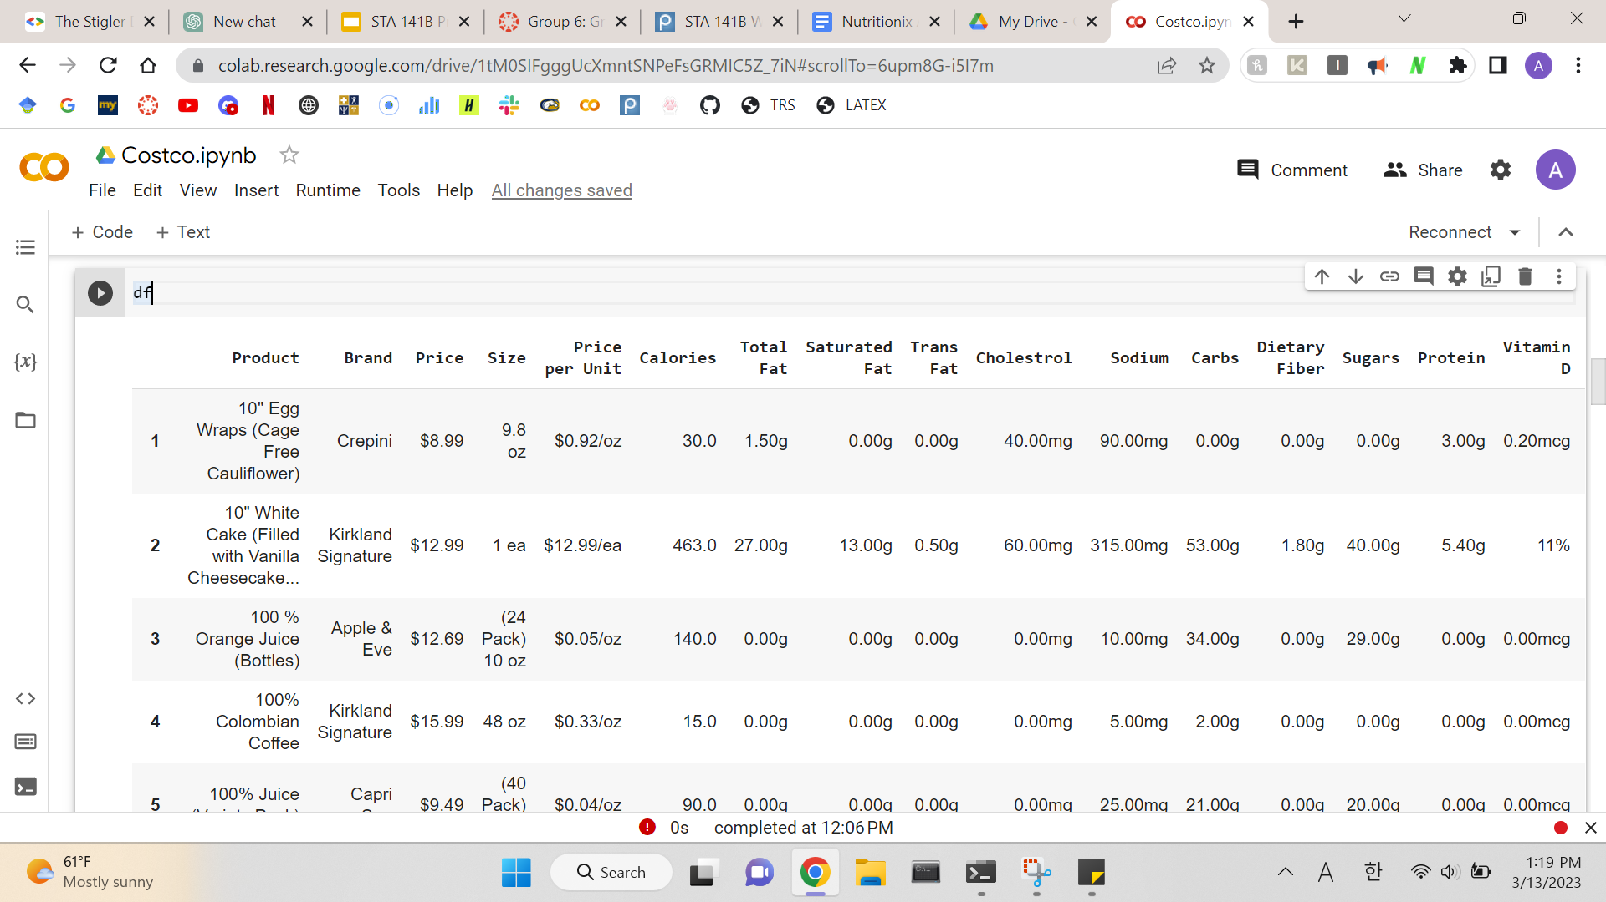
Data Cleaning
Notes:
We have the price information and the nutritional information. But they are separate documents, so we merged them into one dataframe. The dataframe looks like this. We can see that there are units such as dollar signs and gram. The first thing we did was change percentage into microgram or g. Then, we dropped those units and change the integers into floating points. We also dropped unnecessary columns such as brand, saturated/trans fat, cholesterol, etc. And the new dataframe looks like this.

Slide 9
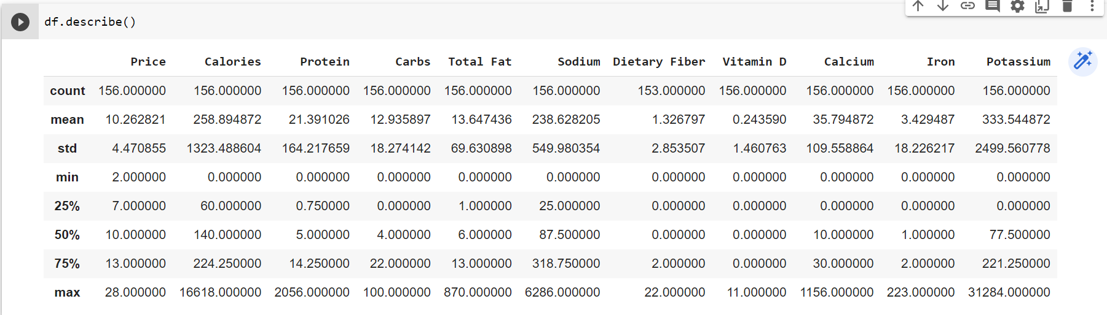
Exploratory Data Analysis
Notes:
First, let’s go ahead and describe our data. I want to point out that the minimum of nutrients are all zero. This is because we replaced nan values into 0. So the 0 indicates no data was available.

Slide 10
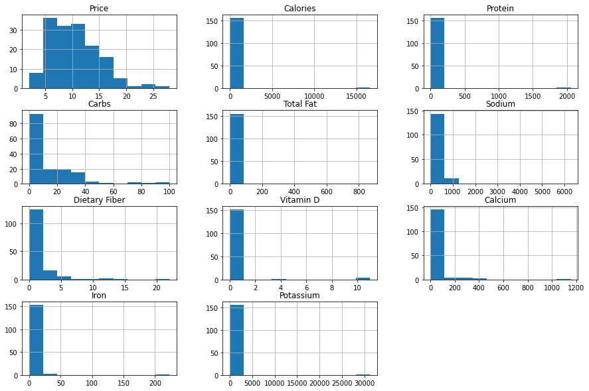
Exploratory Data Analysis
Notes:
The price histogram shows us most food prices are more on the cheap side. The mean seems to be around 10. When looking at the nutritional values, we can tell every one of them has an outlier, and most of them have little nutritional value compared to that outlier.

Slide 11
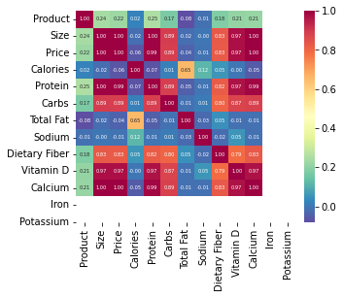
Exploratory Data Analysis
Notes:
Let’s look at the correlation. When you look at the prices and nutritional values, you can see that the price has a strong correlation with the “healthy” nutritional values such as protein and vitamin D. It has a small negative correlation which nutritional values such as sodium and total fat. The white part of the matrix indicates that the correlation is zero. This tells us the more you spend, you will receive more good nutritional values, as expected.

Slide 12
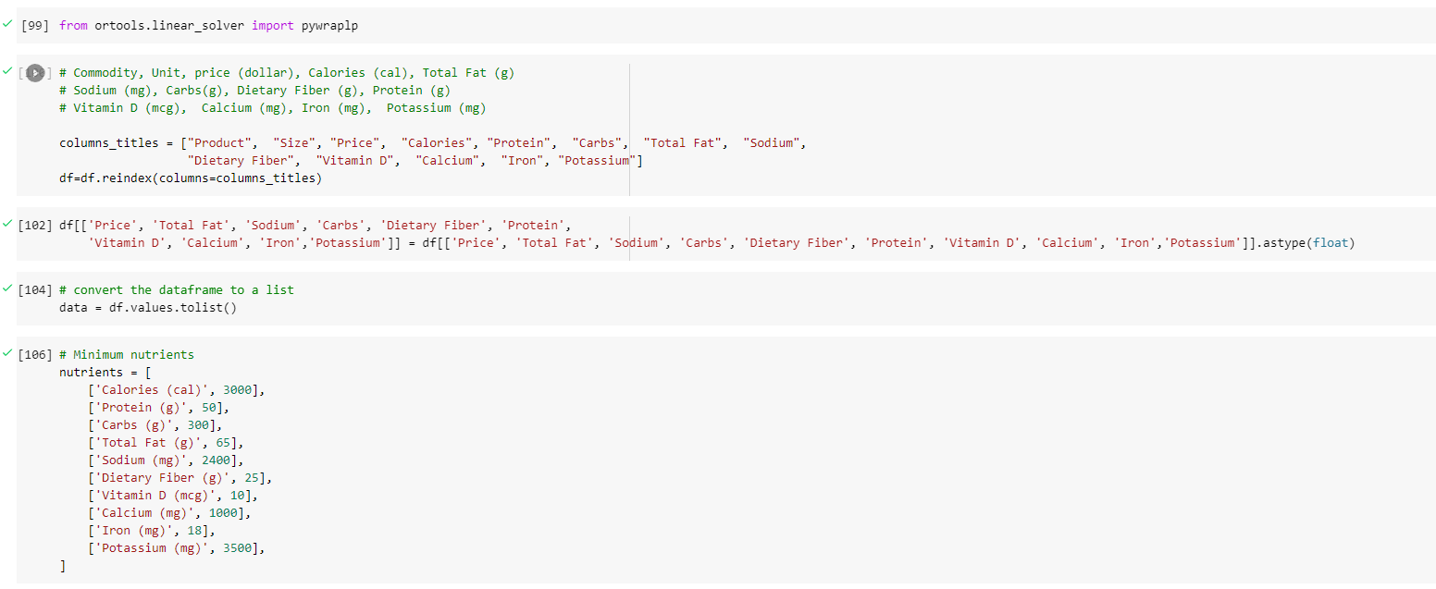
Optimization
Notes:
We are going to use the ortools linear solver. First, reindex the dataframe in order. Also, change the data type to a float. Then, convert the dataframe to a list, since our nutrient requirements data is a list.

Slide 13
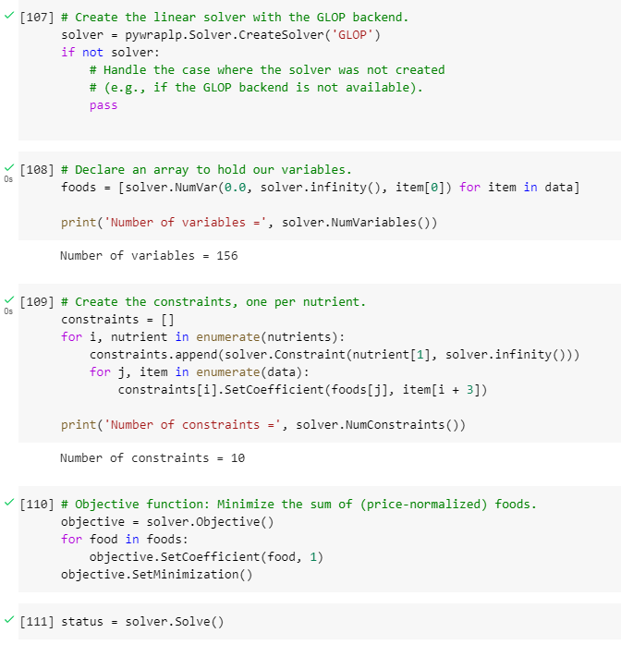
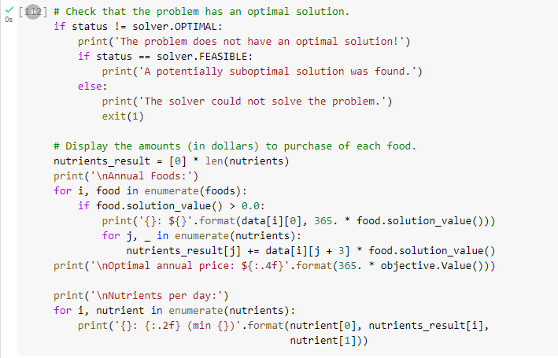
Optimization
Notes:
Create the linear solver with the GLOP backend, which is just a linear optimization solver type. Then declare an array to hold our variables, and we checked that our variable number is 156. Then we created the constraints, which was one per nutrient. We should get 10 as our number of constraints. Then we build our Objective function, which minimizes the sum of price of foods. Then, we go ahead to solve our problem.

Slide 14
03
Interesting Results

Slide 15
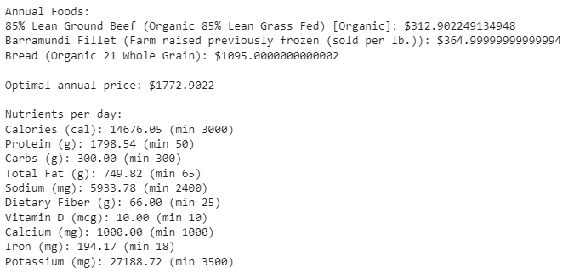
Costco
Notes:
The optimization gives us mostly protein, and a little bit of carbs. The annual price is $1772.9, which is only $147.7/month.
Limitation of stigler diet is of course it is not advised to follow. As you can see in the result, it only gave us three types of food to eat for the entire year. This is not possible, and should not be done. However, you could incorporate those foods in your diet.
Another limitation is that our model only took minimum nutritional values in consideration. You can see that our calories value and other nutritional values are ridiculously large. No everyday person should be eating 14676 calories per day (the recommendation is 3000 calories per day).

Slide 16
Thanks!
Do you have any questions?
Group 6
Aurora Travers, Alex Prado, Ivan Louize Winoto, Lilly Patty, Young Ha
Please keep this slide for attribution

